Slide 1
GENETIC DISORDER, HPO, OMIM and ClinVar
Jan 05 2025
Giảng viên: TS. Lưu Phúc Lợi
Luu.p.loi@googlemail.com

Slide 2
Lecture Content
Genetic disorder
Introduction to HPO (The Human Phenotype Ontology)
Introduction to OMIM (Online Mendelian Inheritance in Man)
Introduction to ClinVar

Slide 3
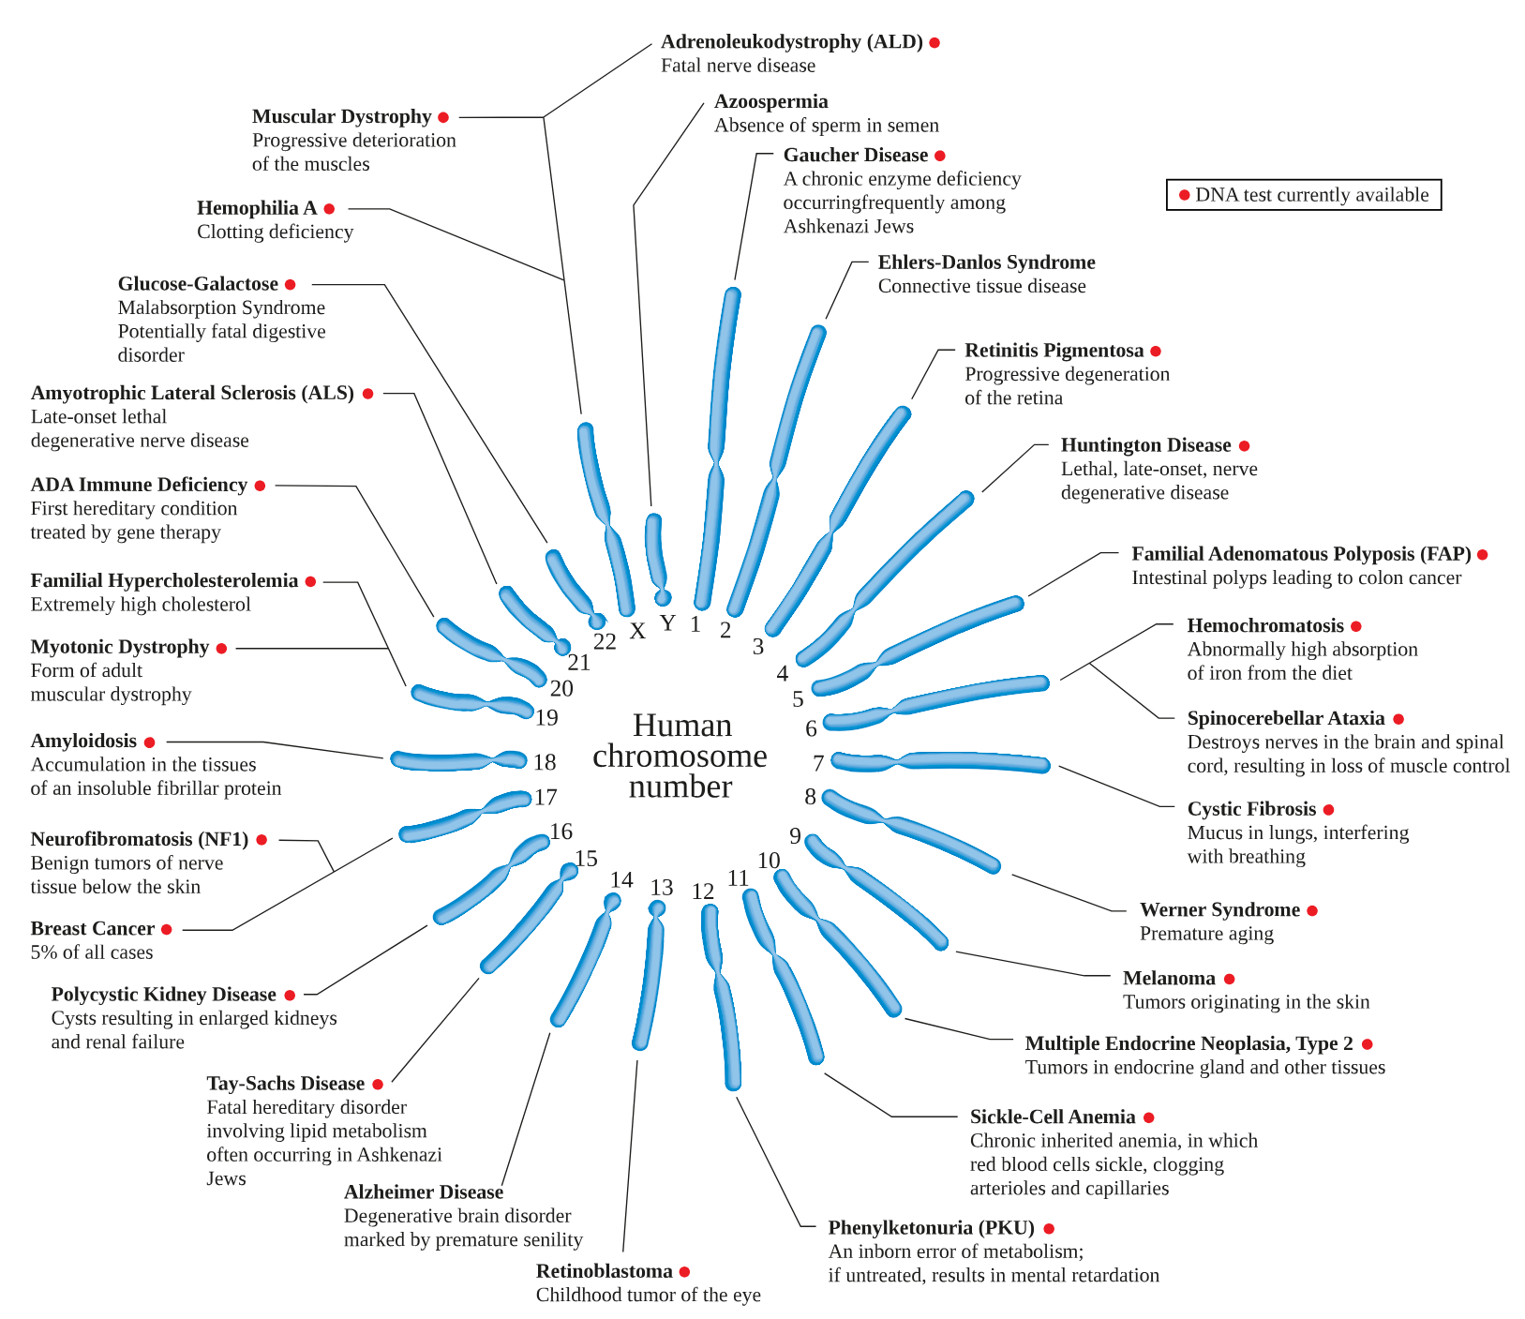
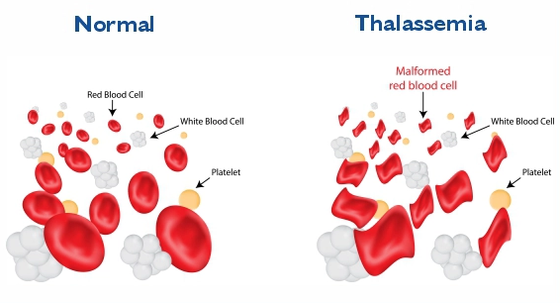
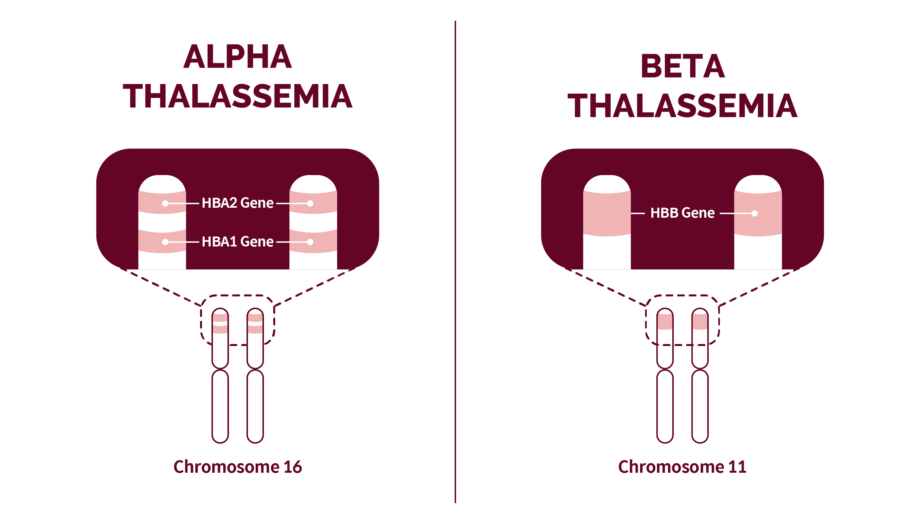
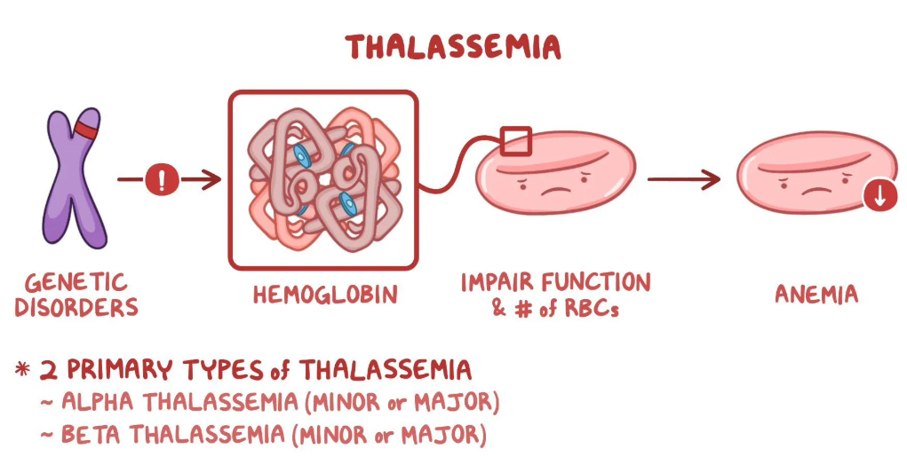
Genetic disorder
A genetic disorder is a health problem caused by one or more abnormalities in the genome. It can be caused by a mutation in a single gene or multiple genes or by a chromosome abnormality.
https://en.wikipedia.org/wiki/Genetic_disorder

Slide 4
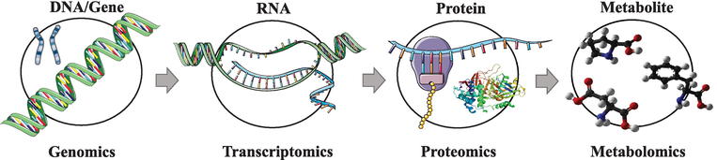
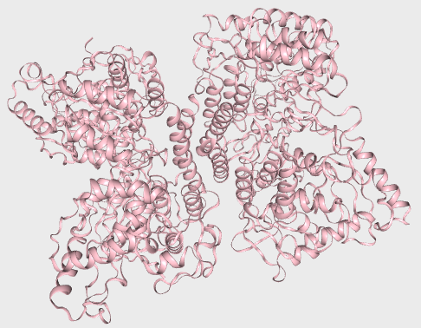
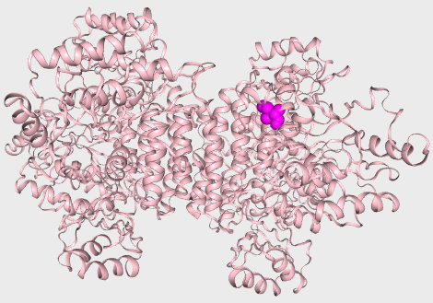
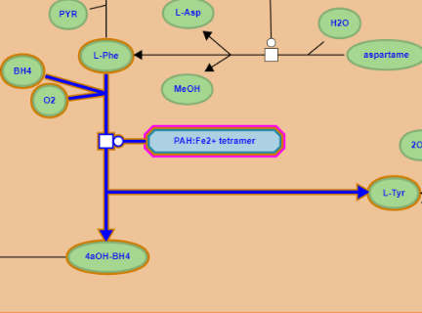
Quan hệ nhân quả: Biến thể gen và bệnh di truyền
PAH gene
Ref …ATCGAT…
P1 …AACGAT…
NM_000277.3(PAH):c.971T>A
PAH mRNA
Ref …AUCGAU…
P1 …AACGAU…
NM_000277.3(PAH):c.971T>A
PAH protein
Ref …Ile-Asp…
P1 …Asn-Asp…
NM_000277.3(PAH):p.Ile324Asn
PAH
Ref Phe → Tyr
PAH
P1 Phe → Tyr
10.5772/intechopen.71769

Slide 5
Genetic classification of hereditary diseases
According to the type of mutation and character of gene – environment interaction genetic disorders can be classified into six categories
Single gene inheritance, or gene disorders (also called Mendelian or monogenic inheritance): autosomal dominant, autosomal recessive, and X-linked.
Chromosome diseases caused by chromosomal and genomic mutations, i.e., structural and numerical abnormalities of chromosomes, respectively.
Multifactorial diseases (also called complex or polygenic diseases) caused by a combination of environmental factors and mutations in multiple genes (i.e., both genetic and non-genetic or environmental factors are involved in determining the trait).
Genetic diseases of somatic cells (De novo). Examples are cancer, autoimmune diseases.
Diseases due to incompatibility of genes. Example is haemolytic disease of newborns, in which fetal red blood cells die earlier due to the action of antibodies formed by the mother against fetal Rh-antigen.
Mitochondrial inheritance: This type of genetic disorder is caused by mutations in the nonchromosomal DNA of mitochondria. Each mitochondrion may contain 5 to 10 circular pieces of DNA.
https://repo.knmu.edu.ua/server/api/core/bitstreams/c5ec2b31-d43a-48a2-818e-7a389d4337c1/content
https://www.garvan.org.au/news-resources/science-explained/genetic-inheritance

Slide 6
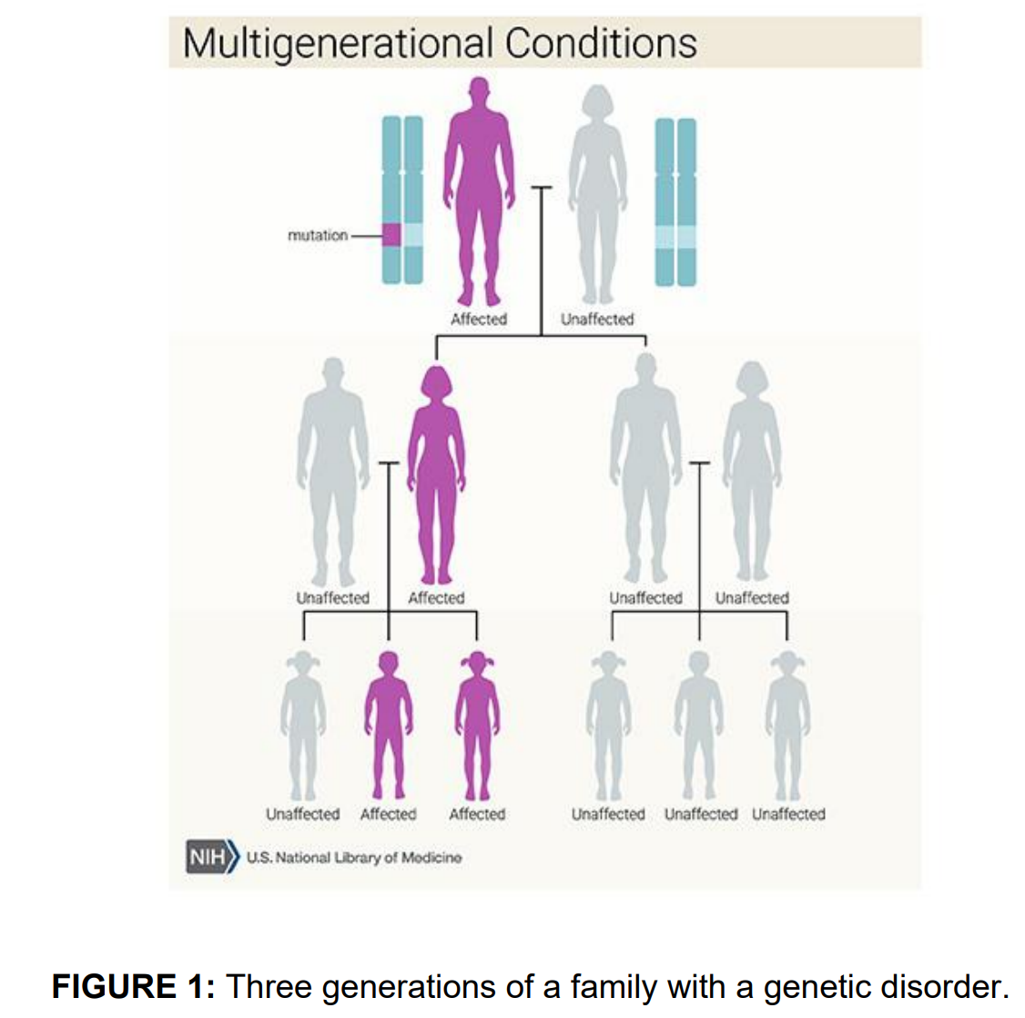
https://medlineplus.gov/genetics/

Slide 7
Single gene inheritance, examples
Huntington's disease is a progressive neurodegenerative disorder that exhibits autosomal dominant inheritance. Other examples of autosomal dominant diseases include Marfan syndrome, neurofibromatosis, retinoblastoma and polydactyly.
Phenylketonuria represents a prominent example of a single gene genetic disorder with an autosomal recessive inheritance pattern. Other examples of autosomal recessive diseases include cystic fibrosis, sickle cell anemia and Tay-Sachs disease.
Hemophilia A is a disorder where the blood cannot clot properly due to a deficiency of a clotting factor called Factor VIII. It exhibits an X chromosome-linked recessive pattern of inheritance, so men with a mutant copy of the gene will always have the disease, whereas women are rarely affected by it. Other examples are Duchenne muscular dystrophy and glucose-6-phosphate dehydrogenase deficiency.
X-linked dominant conditions are rare but do exist. Heterozygous mutations in the X-linked MECP2 gene result in Rett syndrome – a severe neurodevelopmental disorder of young females. A nonobstructive spermatogenic failure that leads to infertility problems in males is an example of a Y-linked disorder.
https://www.news-medical.net/health/Single-Gene-Genetic-Disorder.aspx

Slide 8
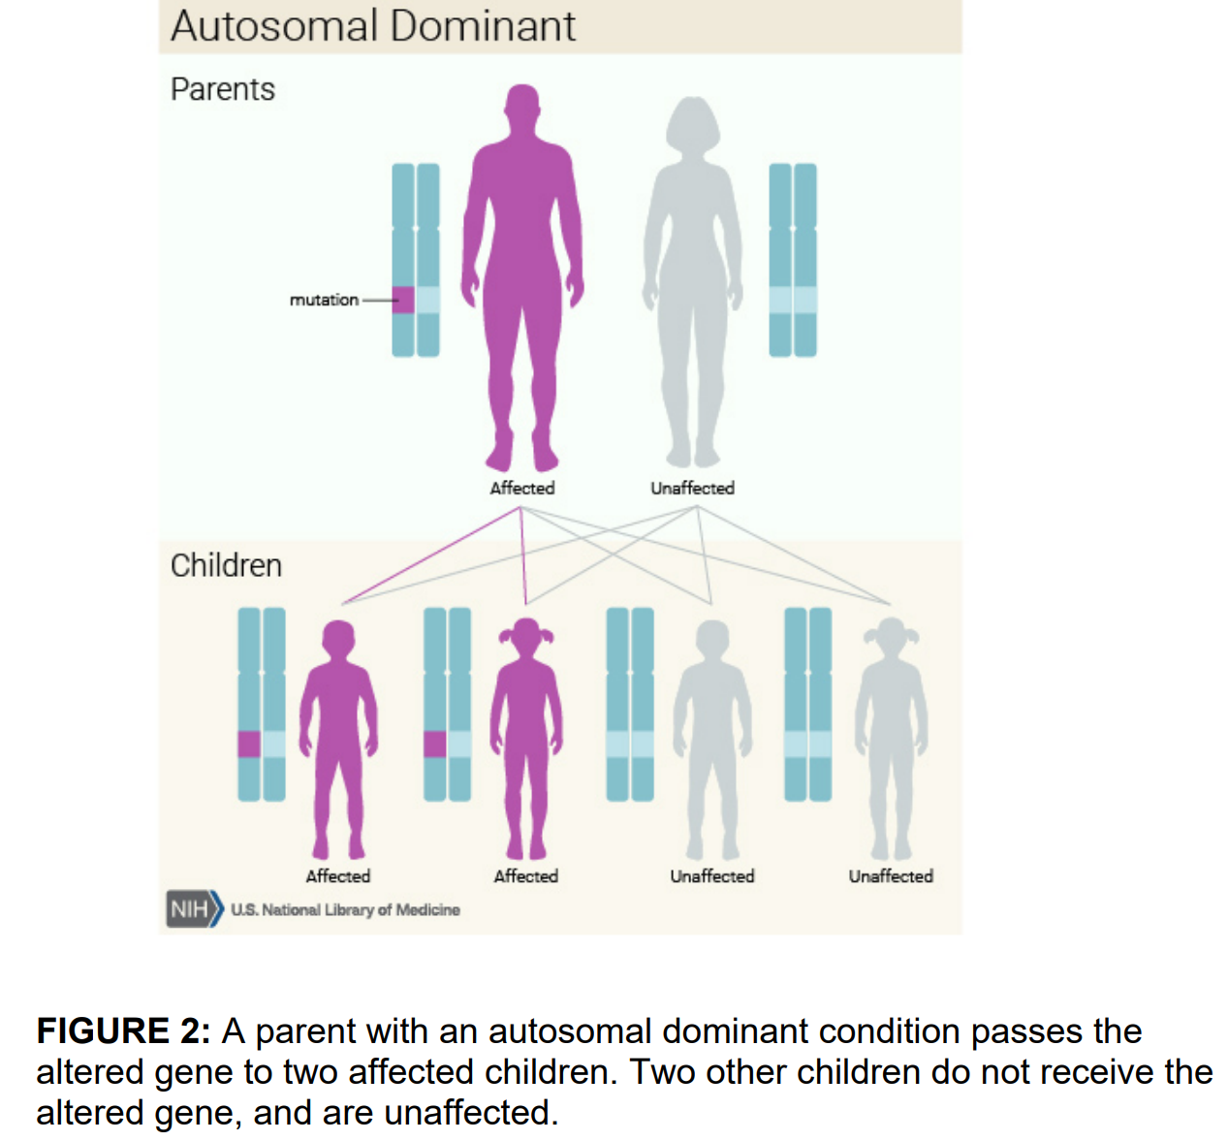
https://medlineplus.gov/genetics/

Slide 9
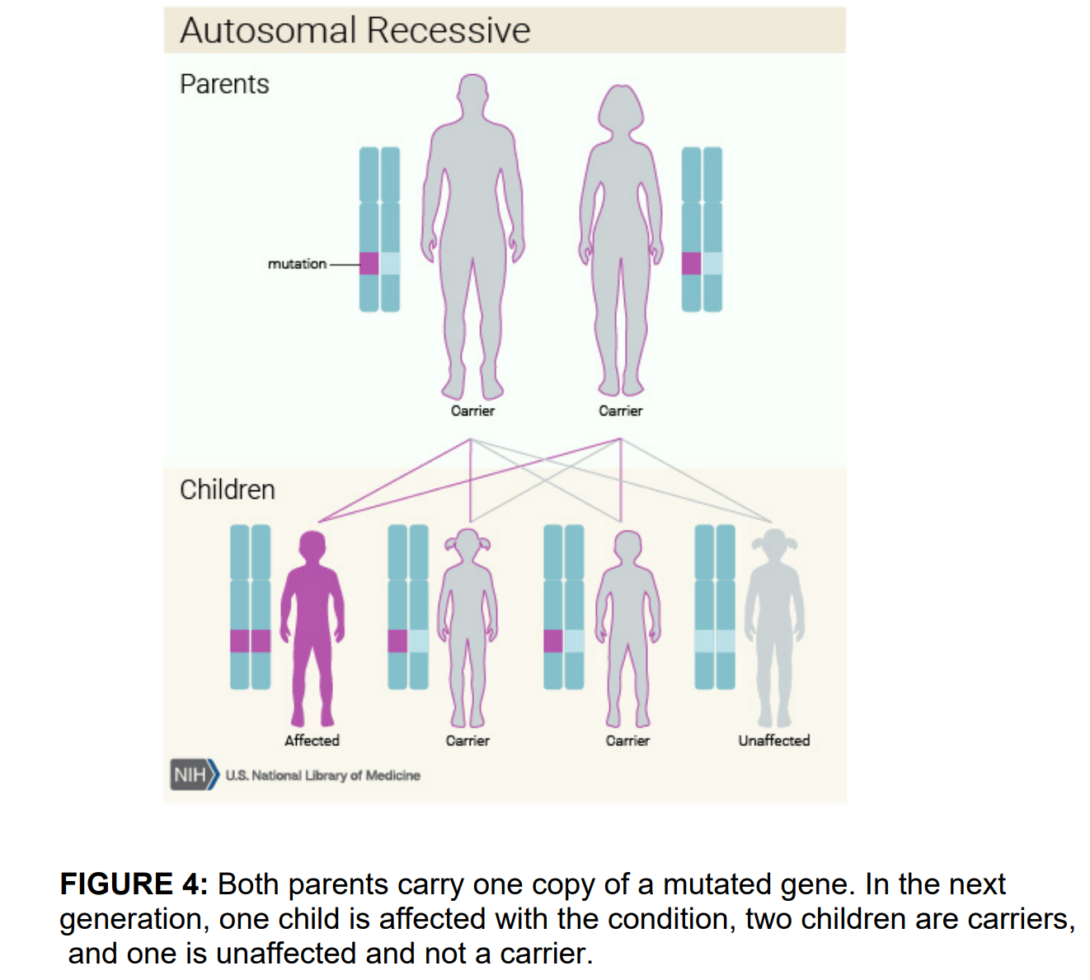
https://medlineplus.gov/genetics/

Slide 10
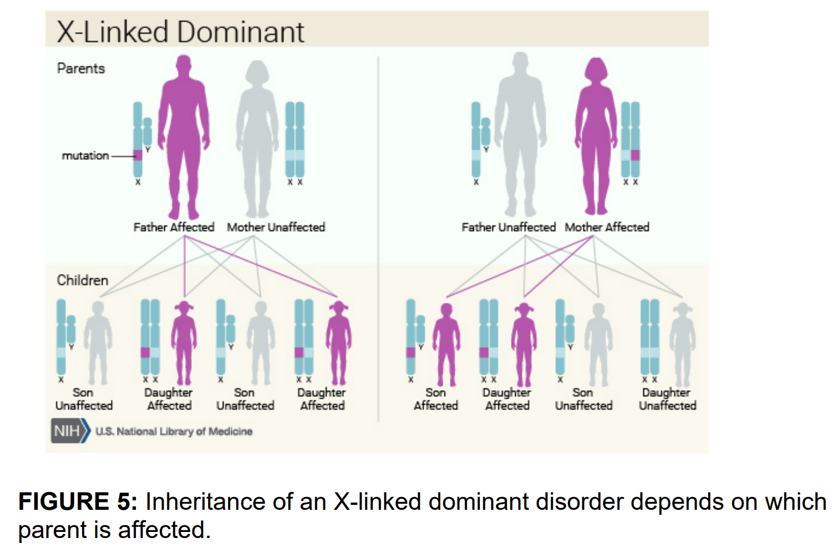
https://medlineplus.gov/genetics/

Slide 11
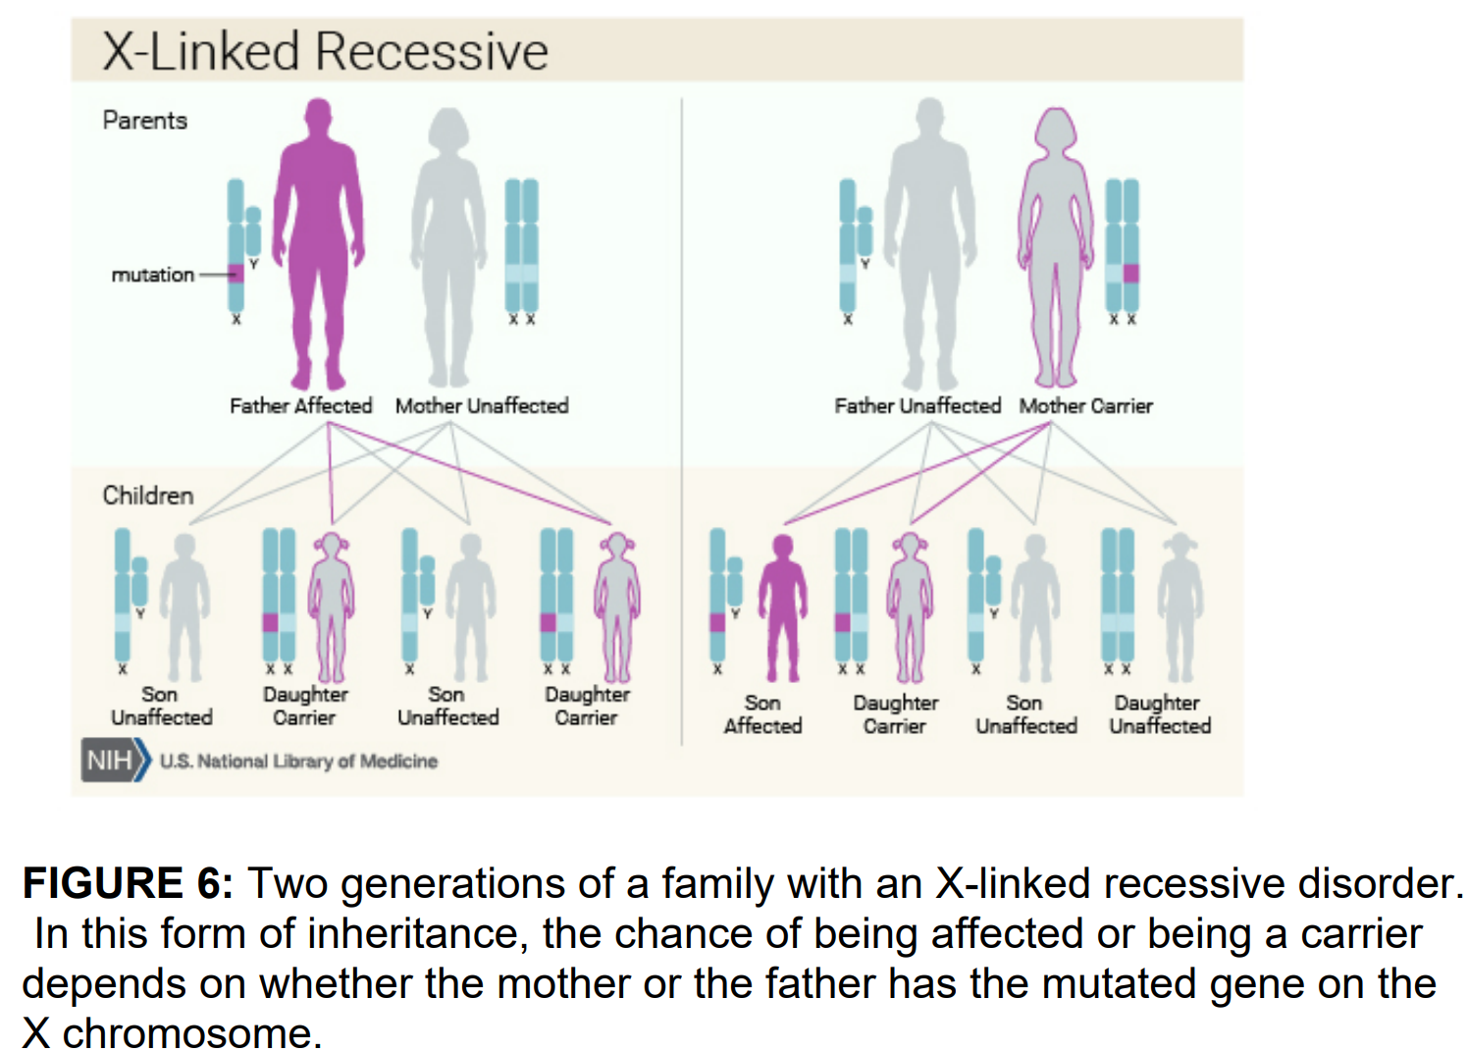
https://medlineplus.gov/genetics/

Slide 12
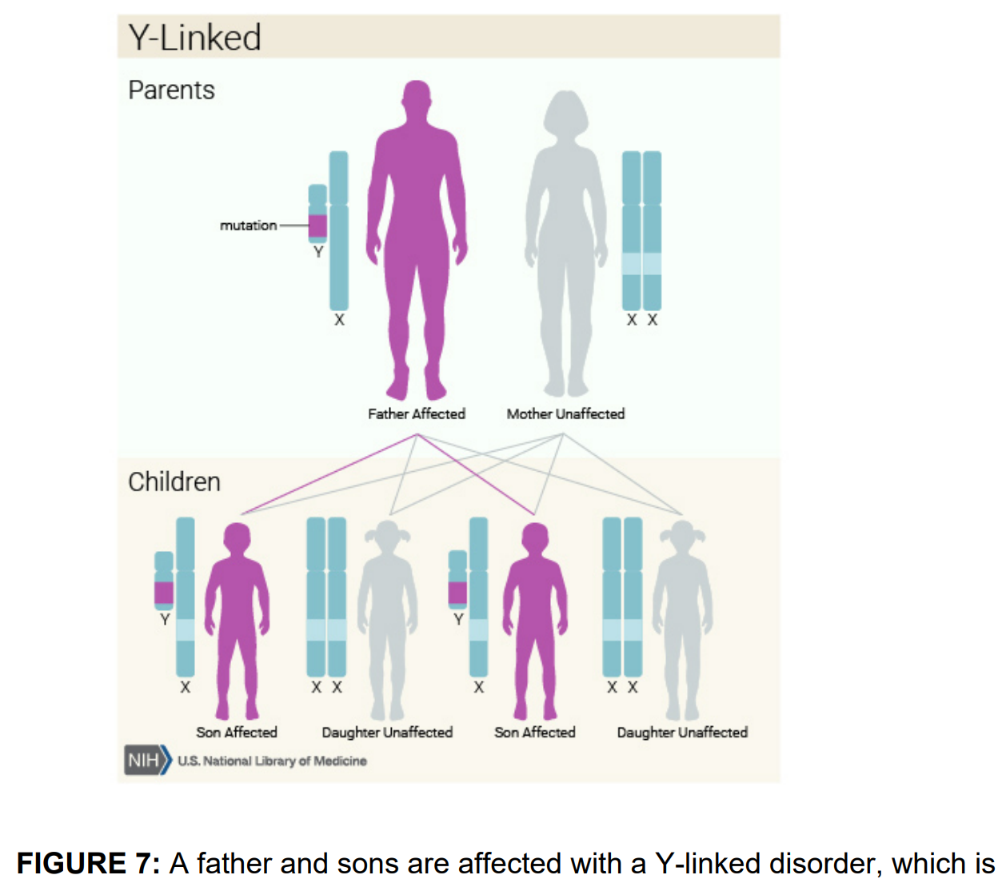
https://medlineplus.gov/genetics/

Slide 13
Chromosome diseases, examples
Down syndrome: Also known as trisomy 21, this is the most common chromosomal disorder and occurs when a person has three copies of chromosome 21 instead of two
Turner syndrome: A monosomy, or the absence of a chromosome, that occurs when a female is born with only one X chromosome
Prader-Willi syndrome: A disease caused by uniparental disomy, which is when a person inherits two pairs of a homologous chromosome from one parent and no copy from the other
Edward's syndrome: Also known as trisomy 18, this is the second most common trisomy after Down syndrome
Patau Syndrome: Also known as trisomy 13, this is the third most common trisomy after Down syndrome and Edward's syndrome
13q deletion syndrome: A rare chromosomal disorder
18q deletion syndrome: A common syndrome that occurs in about 1 in 10,000 live births
https://www.ncbi.nlm.nih.gov/books/NBK557691/

Slide 14
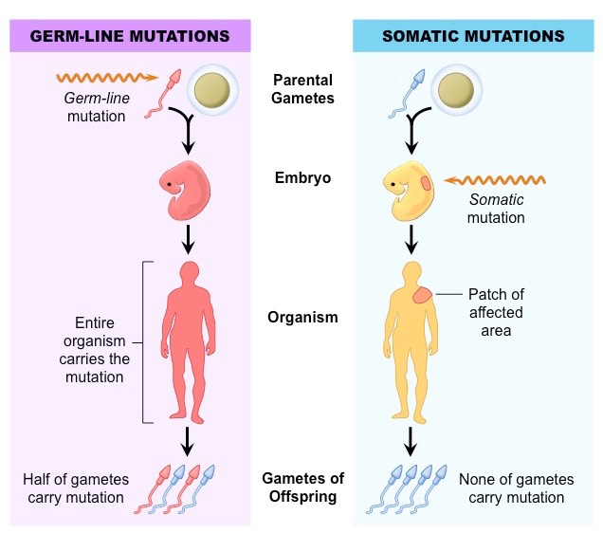
Genetic diseases of somatic cells
https://old-ib.bioninja.com.au/standard-level/topic-3-genetics/33-meiosis/somatic-vs-germline-mutatio.html

Slide 15
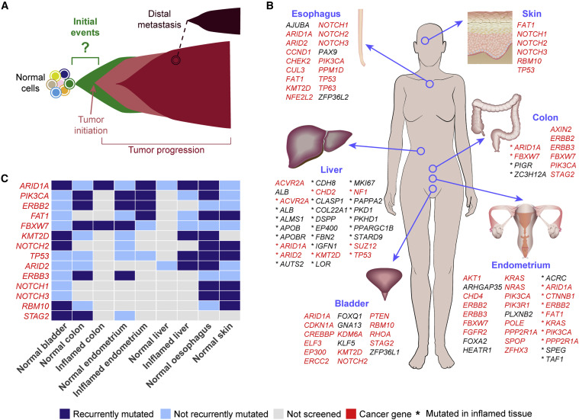
Genetic diseases of somatic cells, example: cancer
Landscape of Somatic Mutations in Human Adult Tissues
Schematics of cancer initiation and progression. The initial driver events that lead to tumor formation starting from normal cells are currently mostly unknown.
Mutated genes under positive selection (Brunner et al., 2019; Lawson et al., 2020; Lee-Six et al., 2019; Martincorena et al., 2015, 2018; Moore et al., 2020; Olafsson et al., 2020; Yokoyama et al., 2019) or frequently mutated (Anglesio et al., 2017; Lac et al., 2019a, 2019b; Lee-Six et al., 2019; Suda et al., 2018; Yokoyama et al., 2019; Zhu et al., 2019) in the human adult tissues that have been screened so far.
List of genes under positive selection or frequently mutated in at least two tissues. Cancer genes were derived from the Network of Cancer Genes (http://ncg.kcl.ac.uk/) (Repana et al., 2019).
https://doi.org/10.1016/j.ccell.2020.11.002

Slide 16
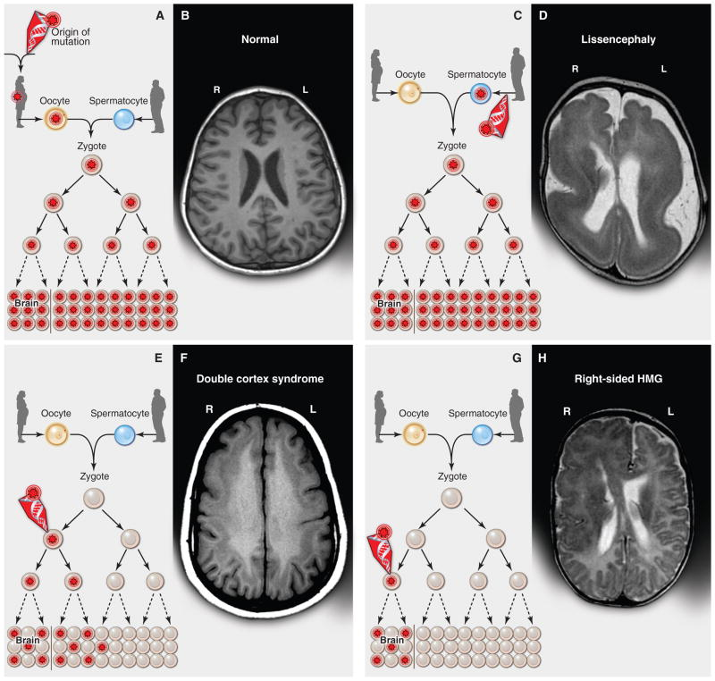
Genetic diseases of somatic cells, example: epilepsy
(A) A heterozygous mutation is inherited from one parent. This mechanism is typical of autosomal dominant epilepsy. In this example, the mutation originally presented in the mother, whose oocytes in turn carry the mutation. (The mutation arose during gametogenesis in one of the parents of the mother, top left.) It is present in the zygote and thus all cells of the affected child. (B) This axial T1-weighted image from a MRI study of a patient with inherited epilepsy appears normal. Individuals with dominantly inherited epilepsies caused by mutations in genes encoding ion channels, for example, have normal neuroimaging studies despite every cell carrying a mutation. (C) A de novo mutation may arise sporadically during gametogenesis, in this case spermatogenesis. This mechanism of mutation would be typical of a de novo mutation in the gene SCN1A associated with severe myoclonic epilepsy of infancy or LIS1 associated with lissencephaly. Even though every cell in the individual carries the mutation, the predominant effects of the mutation depend on the distribution of gene expression; in these examples, the brain is primarily affected. (D) An axial T2-weighted MRI image shows the severe gyral simplification—more pronounced posteriorly (the bottom of the figure)—that is associated with mutations in the gene LIS1. (E) An early post-zygotic mutation results in a mutation present in most or all tissues of the organism (including the leukocytes, which are generally assayed for clinical genetic testing) but in a mosaic fashion, with only a portion of all cells in each tissue harboring the mutation. This pattern, illustrated by the axial T1-weighted image in (F), has been observed in mosaic cases of double cortex syndrome involving the gene DCX. Visible is the extra band of gray matter underlying the normal-appearing outer aspect of the cerebral cortex. Because DCX is required for normal migration of neurons from the ventricular region deep in the brain to the superficial cortex, the cells carrying the DCX mutation only migrate about halfway to the cortex and then arrest their migration. (G) A late post-zygotic mutation will be present in only certain tissues in a mosaic fashion, in this case apparently in half of the brain. This is the pattern observed in some cases of HMG with somatic mosaic point mutations in AKT3 and other related genes and somatic mosaic increase of copy number of chromosome 1q. (H) This axial T2-weighted MRI image shows right-sided HMG, characterized here by enlargement of the right hemisphere, abnormally thick and dark-appearing gray matter anteriorly, heterotopic periventricular gray matter, and abnormal white matter signal in the right hemisphere. (R, right; L, left).
https://pmc.ncbi.nlm.nih.gov/articles/PMC3909954/

Slide 17
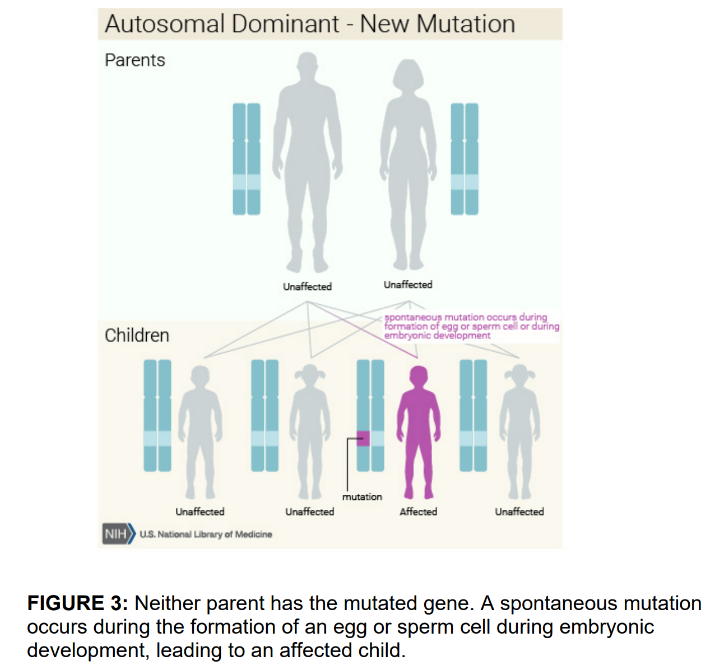

Slide 18
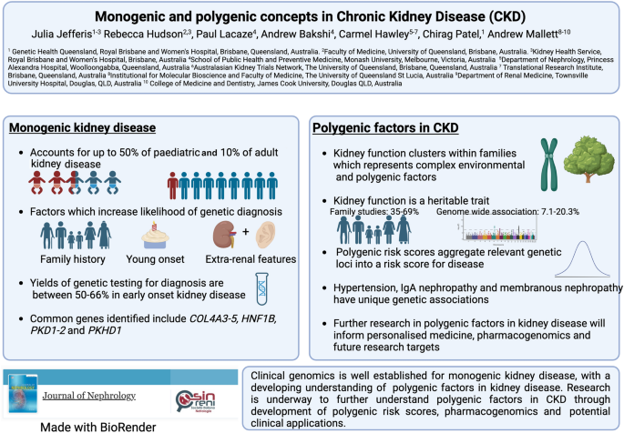
https://link.springer.com/article/10.1007/s40620-023-01804-8

Slide 19
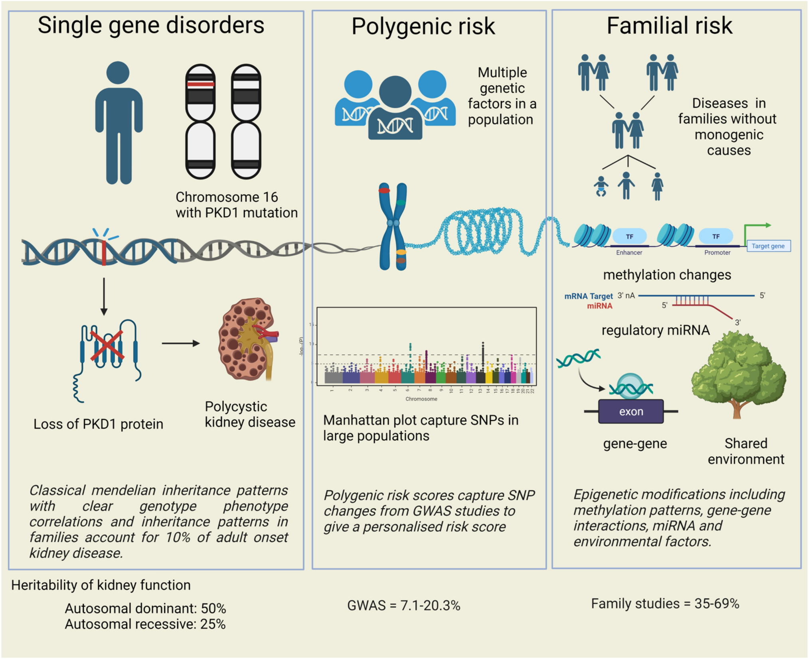
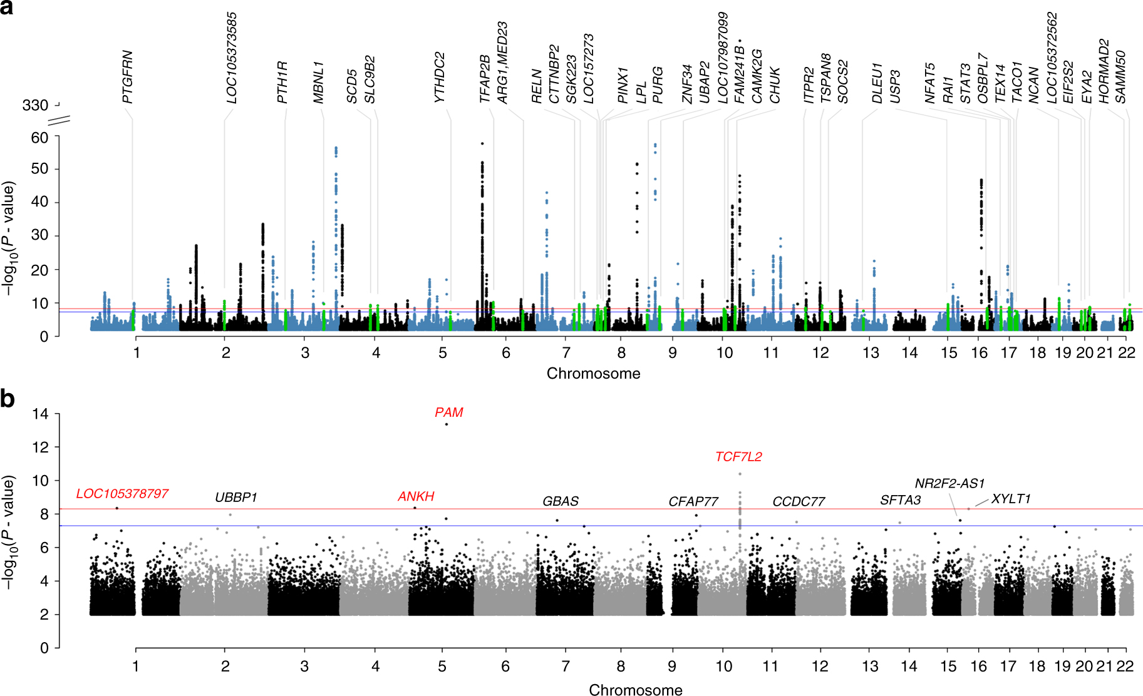
Monogenic vs polygenic diseases
Manhattan plots of common- and rare-variant associations for T2D. a GWAS results for common variants (MAF ≥ 0.01) in the meta-analysis. The 39 novel loci are annotated and highlighted in green. b GWAS results of rare variants (0.0001 ≤ MAF < 0.01) in UKB. Four loci with P < 5 × 10⁻⁹ are highlighted in red. The blue lines denote the genome-wide significant threshold of P < 5 × 10⁻⁸, and the red lines denote a more stringent threshold of P < 5 × 10⁻⁹
https://link.springer.com/article/10.1007/s40620-023-01804-8
https://www.nature.com/articles/s41467-018-04951-w

Slide 20
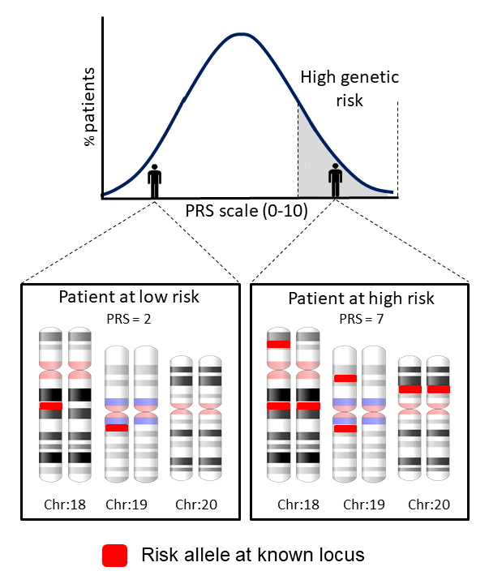
Multifactorial diseases
Complex or polygenic diseases caused by a combination of environmental factors and mutations in multiple genes (i.e., both genetic and non-genetic or environmental factors are involved in determining the trait).
For example, different genes that influence breast cancer susceptibility have been found on chromosomes 6, 11, 13, 14, 15, 17, and 22. Some common chronic diseases are multifactorial disorders (e.g., atherosclerosis, hypertention, ulcer disease, Alzheimer disease, arthritis, diabetes, cancer, and obesity).
DOI:10.3390/ijms20164004

Slide 21
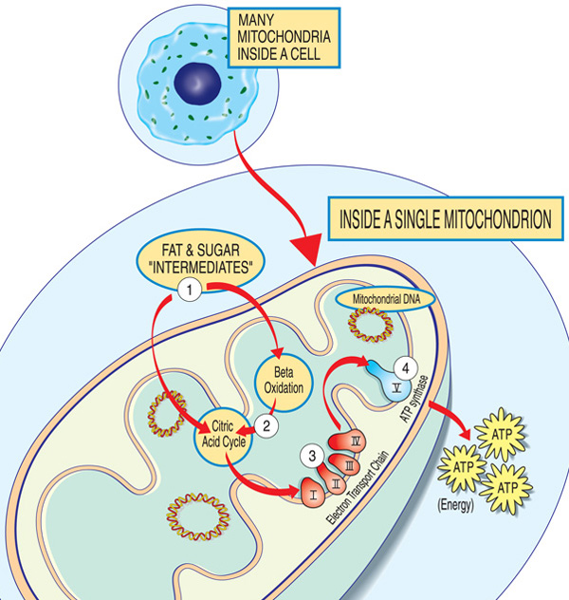
Mitochondrial inheritance
Each mitochondrion is an energy factory that “imports” sugars and fats, breaks them down and “exports” energy (ATP) via these steps: Fat and sugar intermediates enter the mitochondrion. Fatty acids are broken down through beta oxidation and the removal of electrons in the citric acid cycle. Electrons are passed through the major complex of the electron transport chain. ATP is made by ATP synthase.
https://www.mda.org/disease/mitochondrial-myopathies/causes-inheritance

Slide 22
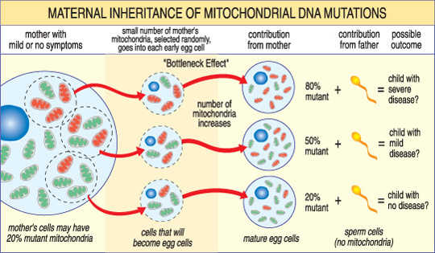
Mitochondrial inheritance
The severity of a mitochondrial disease in a child depends on the percentage of abnormal (mutant) mitochondria in the egg cell that formed them.
https://www.mda.org/disease/mitochondrial-myopathies/causes-inheritance

Slide 23
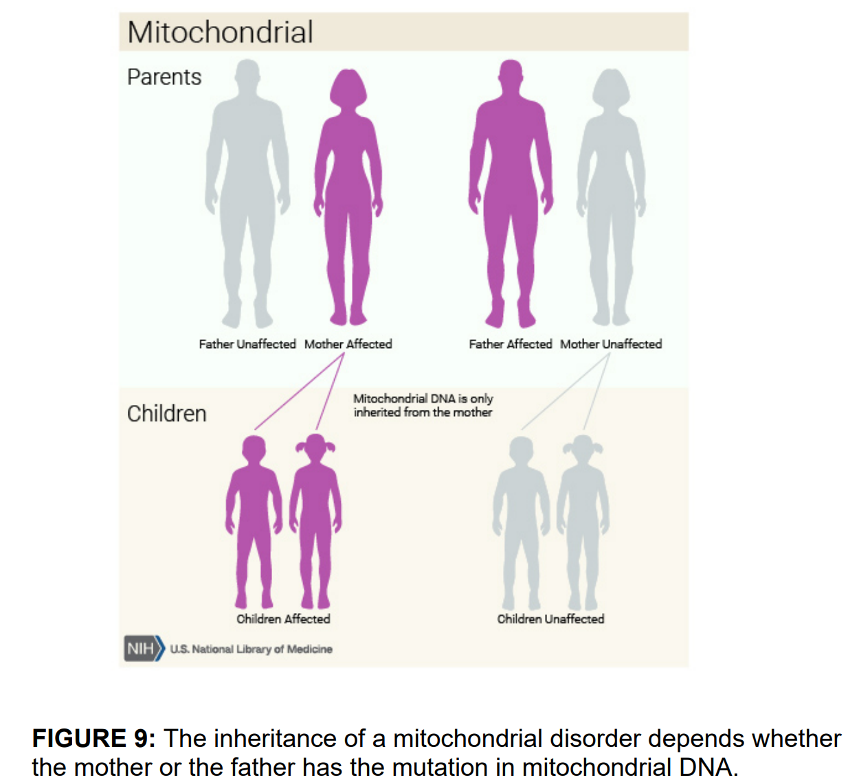
https://medlineplus.gov/genetics/

Slide 24
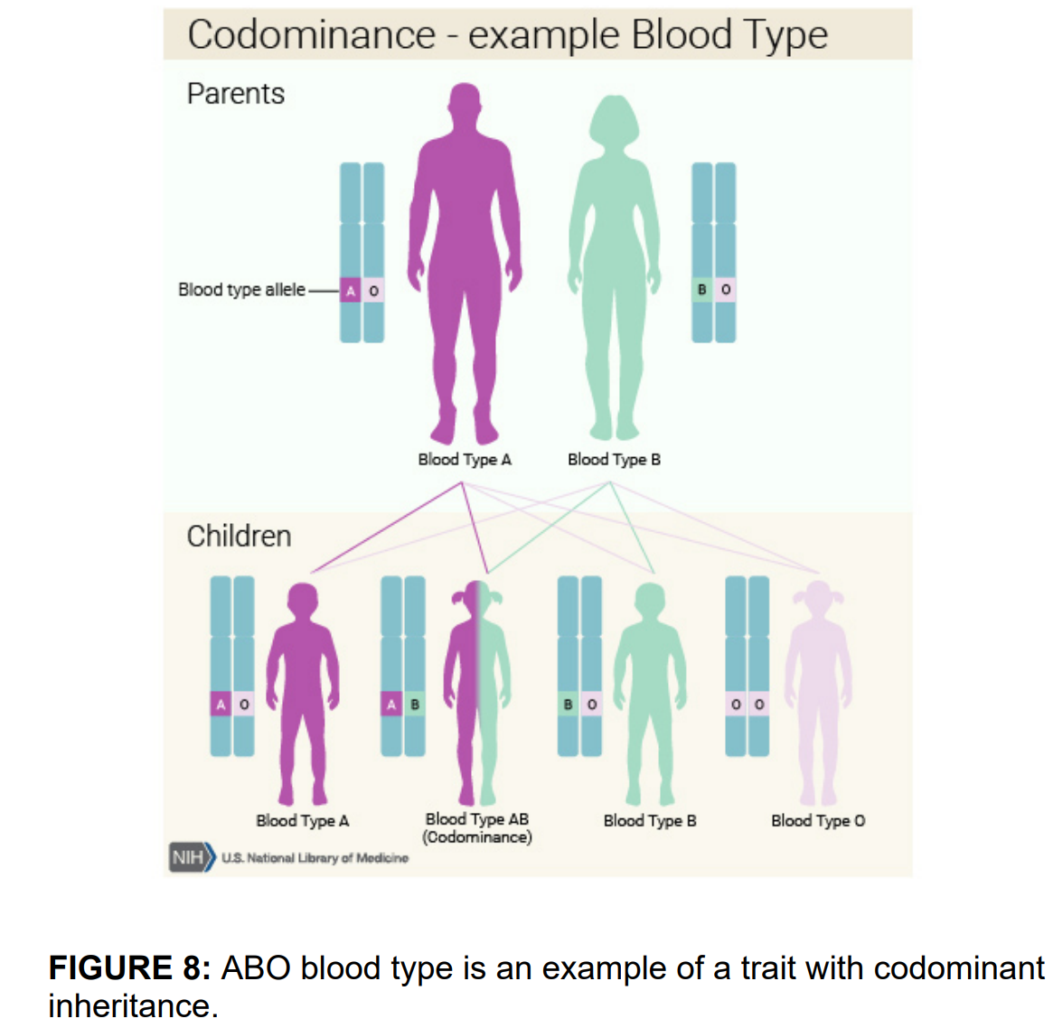
https://medlineplus.gov/genetics/

Slide 25
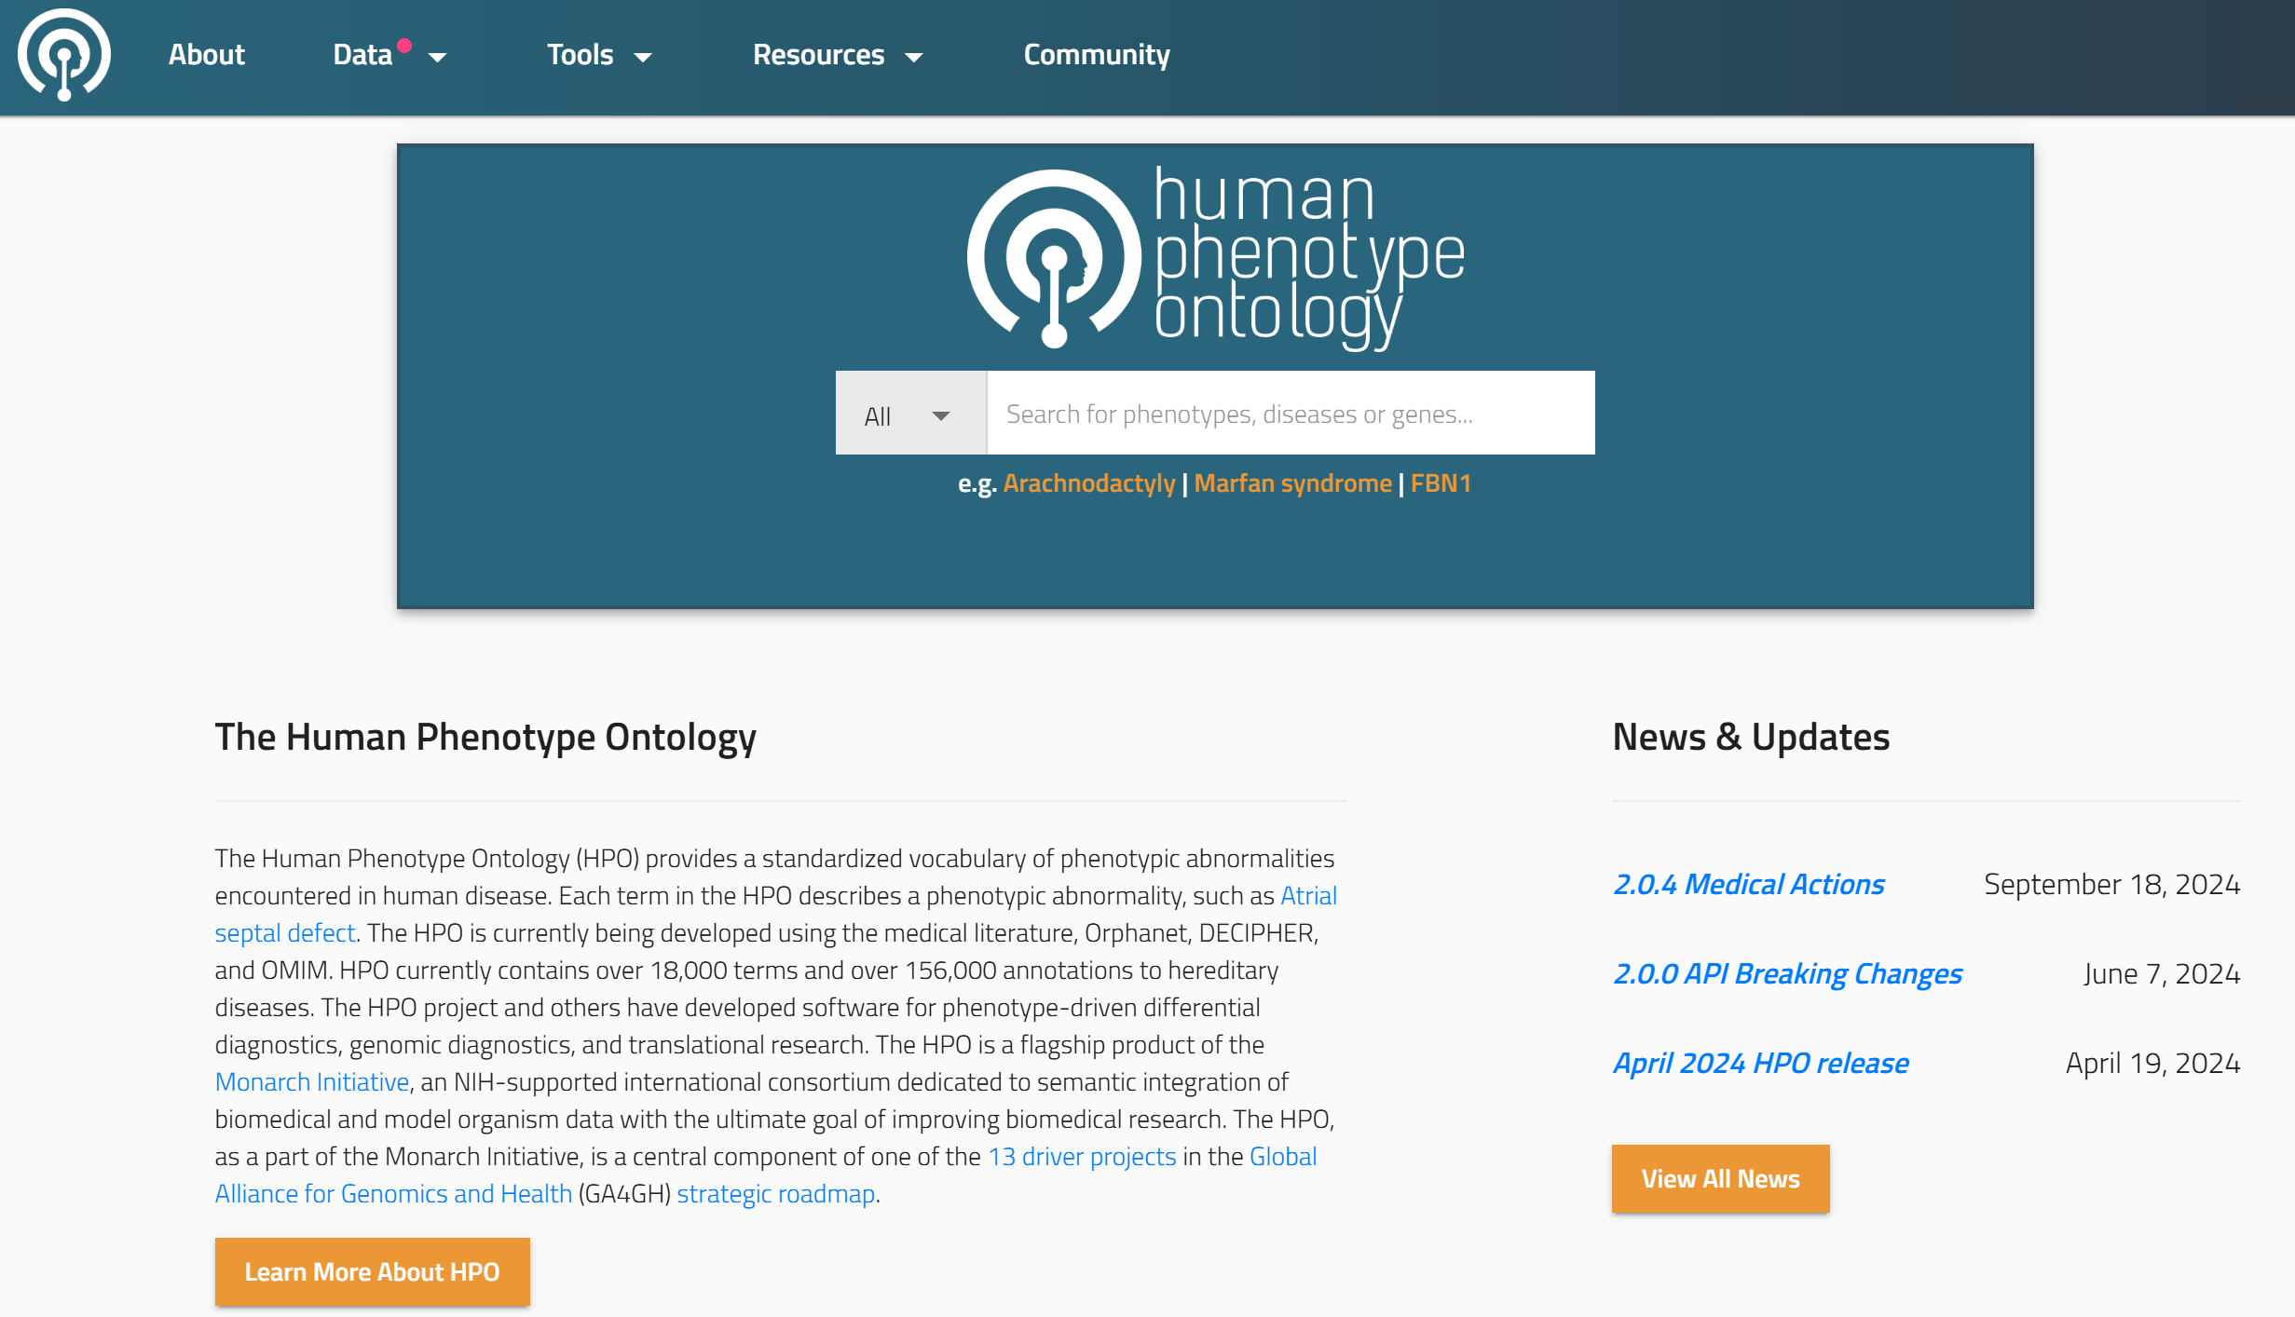
The Human Phenotype Ontology (HPO)
https://hpo.jax.org/

Slide 26
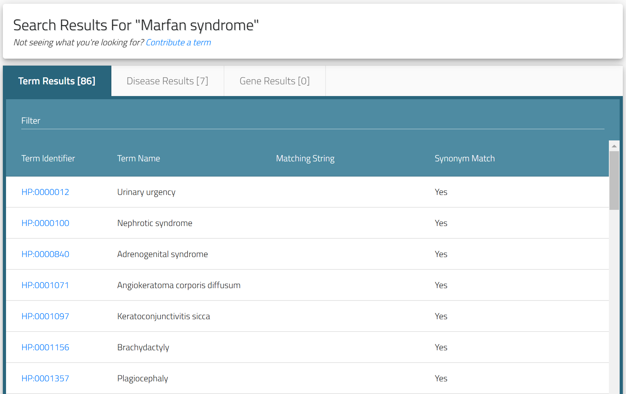
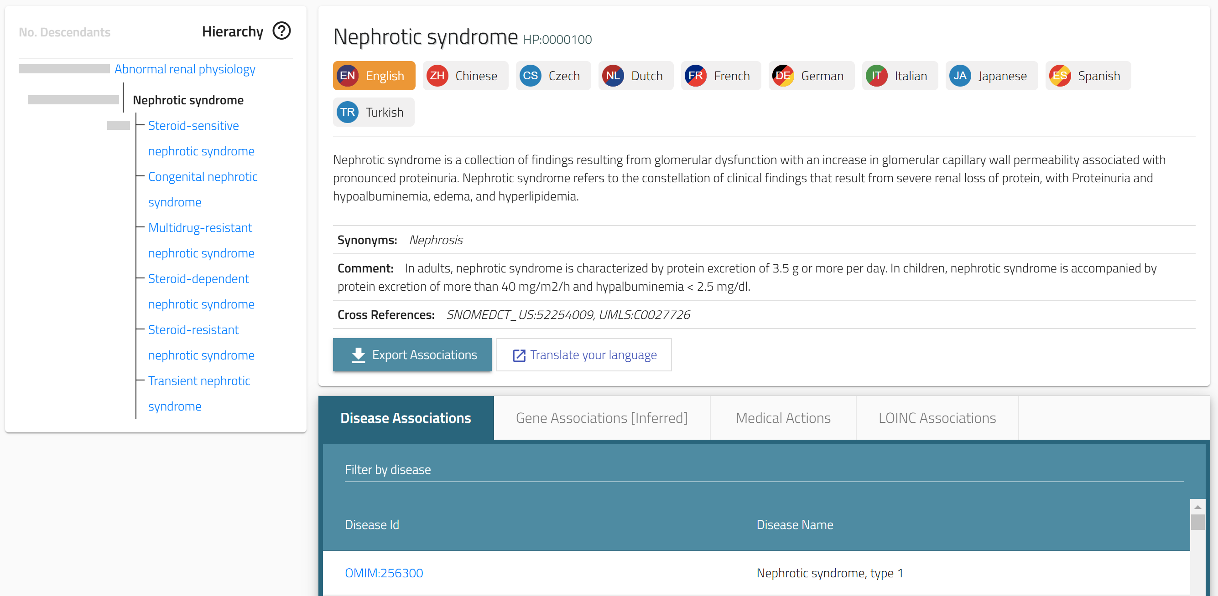
The Human Phenotype Ontology (HPO)
The Human Phenotype Ontology (HPO) provides a standardized vocabulary of phenotypic abnormalities encountered in human disease.
Each term in the HPO describes a phenotypic abnormality, such as Atrial septal defect.
The HPO is currently being developed using the medical literature, Orphanet, DECIPHER, and OMIM.
HPO currently contains over 18,000 terms and over 156,000 annotations to hereditary diseases.
The HPO project and others have developed software for phenotype-driven differential diagnostics, genomic diagnostics, and translational research.
https://hpo.jax.org/

Slide 27
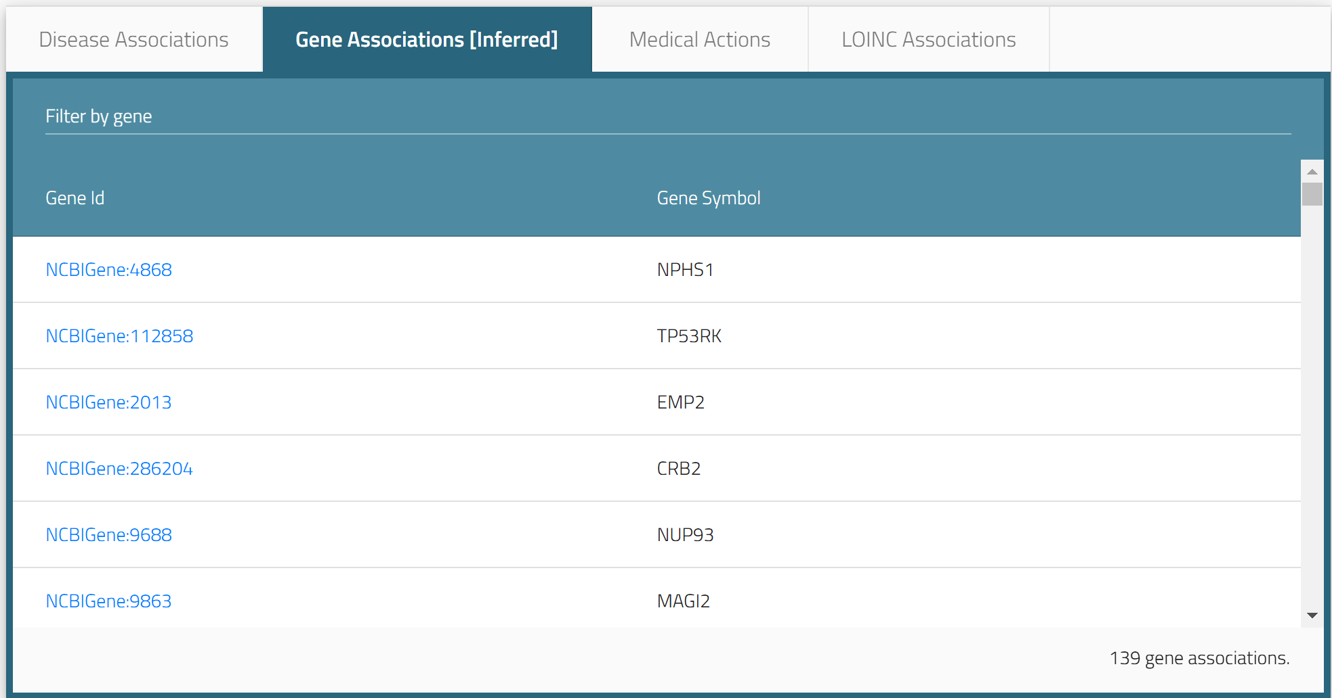
The Human Phenotype Ontology (HPO)
https://hpo.jax.org/browse/term/HP:0000100

Slide 28
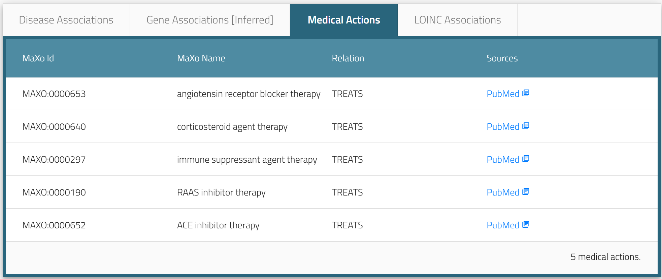
The Human Phenotype Ontology (HPO)
https://hpo.jax.org/browse/term/HP:0000100

Slide 29
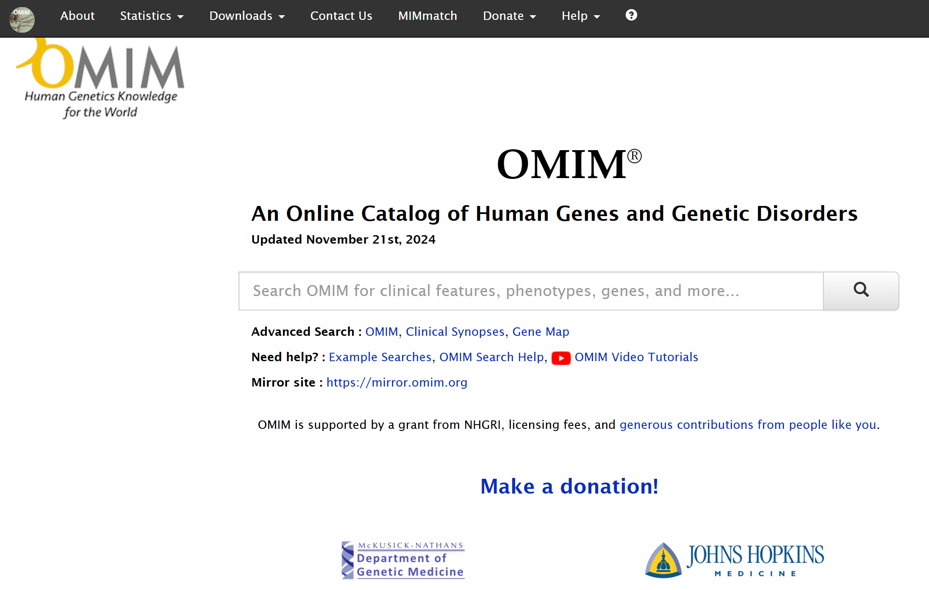
OMIM: An Online Catalog of Human Genes and Genetic Disorders
https://omim.org/

Slide 30
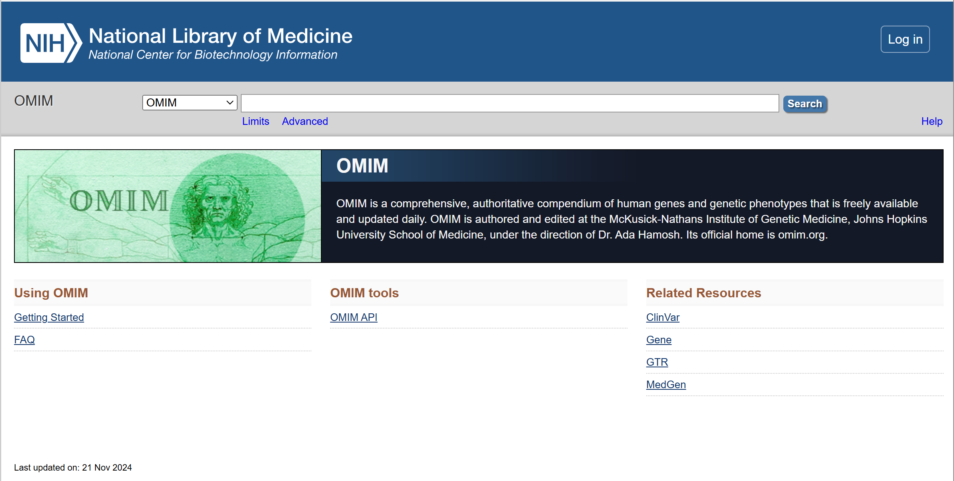
NCBI OMIM: An Online Catalog of Human Genes and Genetic Disorders
https://www.ncbi.nlm.nih.gov/omim

Slide 31
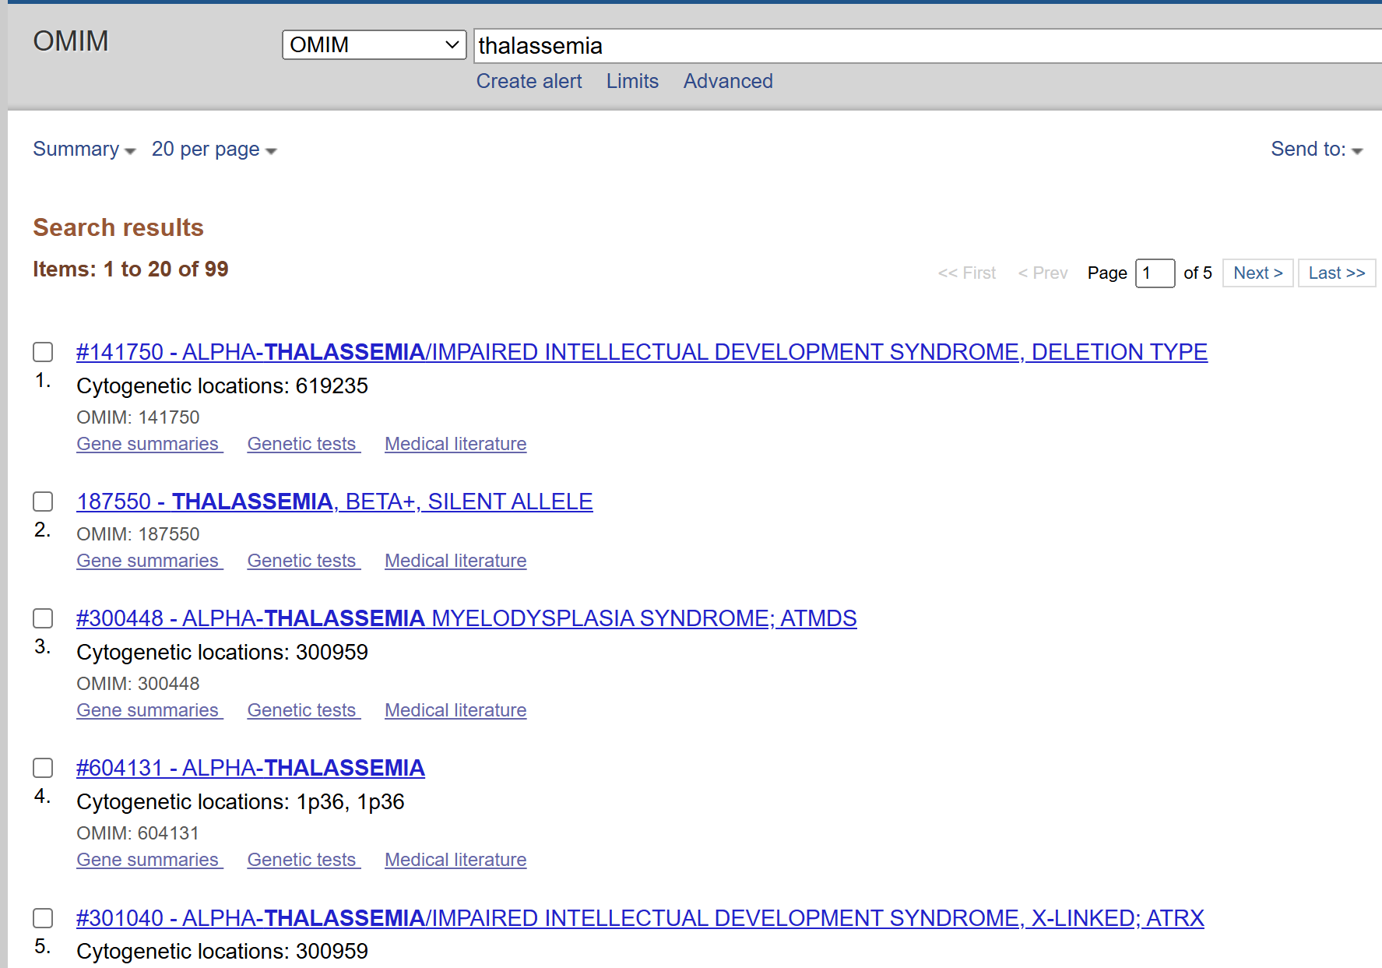
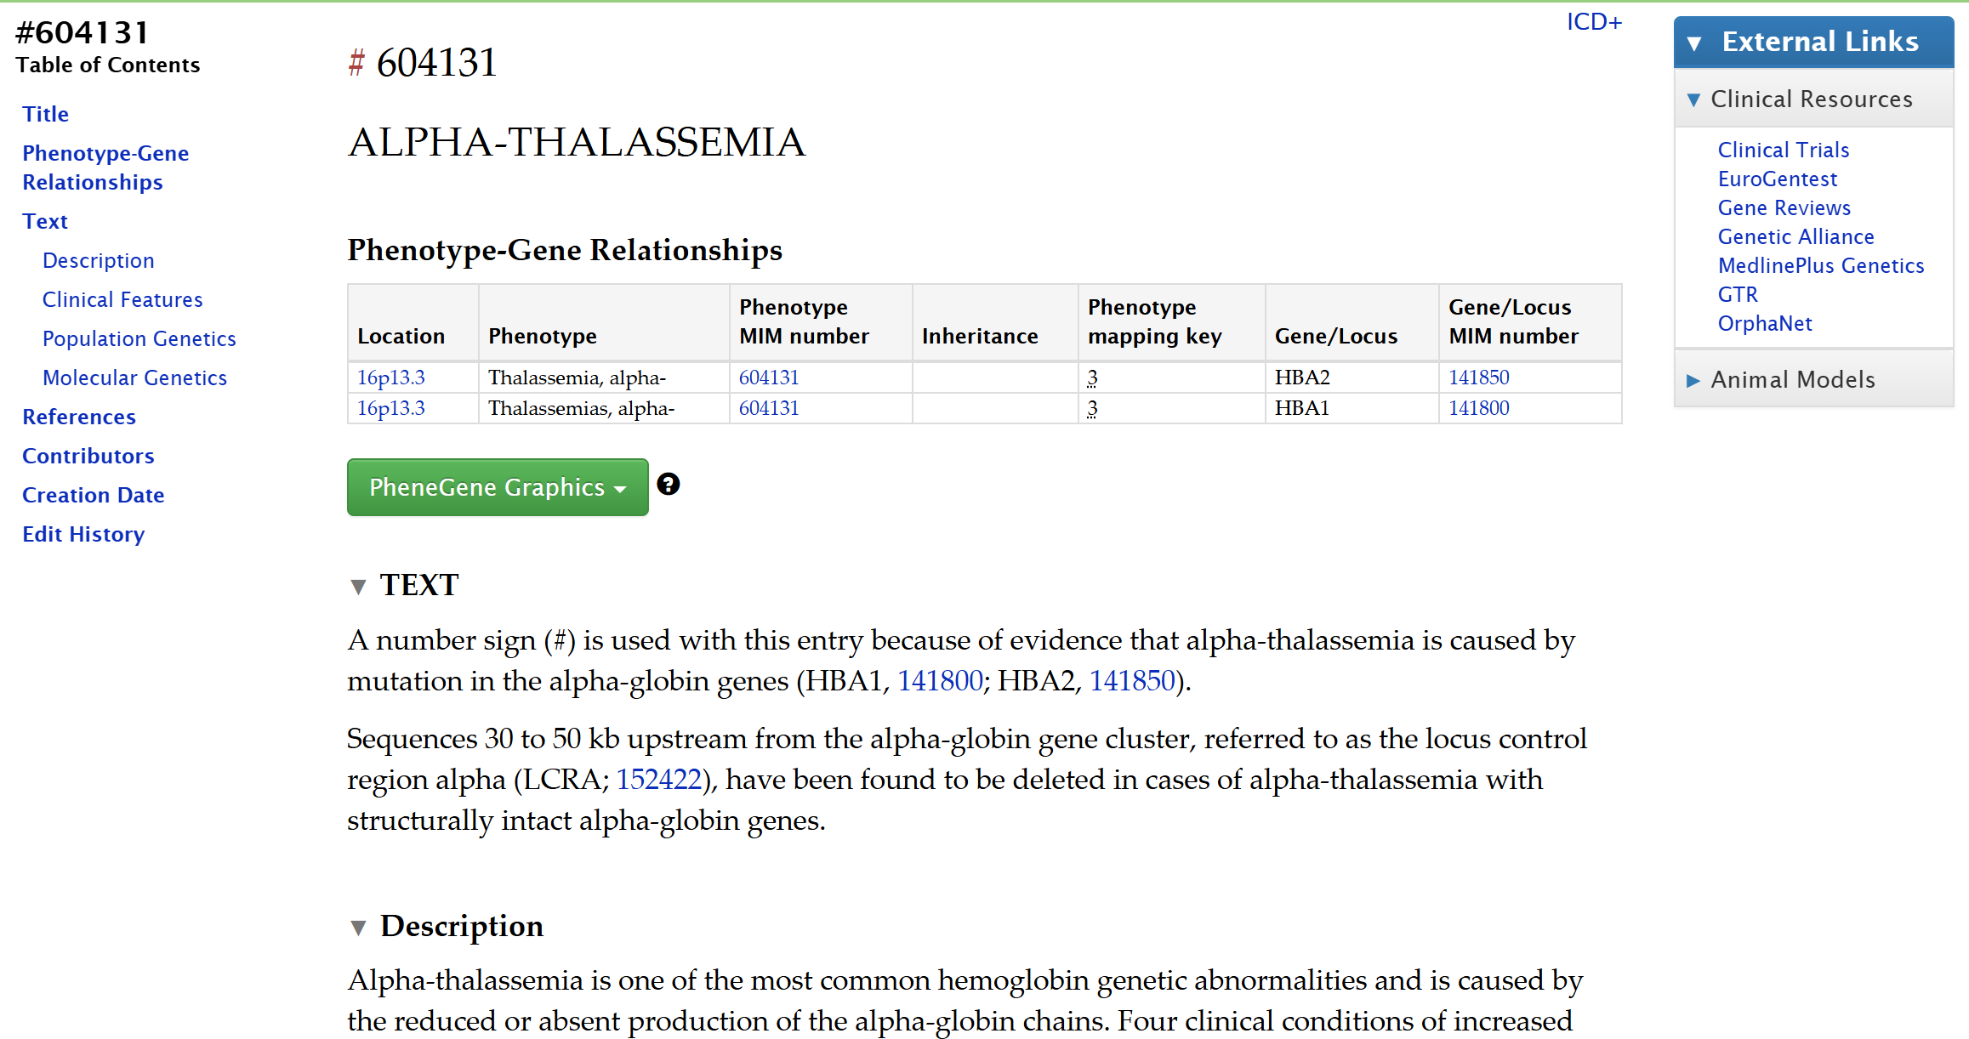
NCBI OMIM: An Online Catalog of Human Genes and Genetic Disorders
https://www.ncbi.nlm.nih.gov/omim
https://omim.org/entry/604131

Slide 32
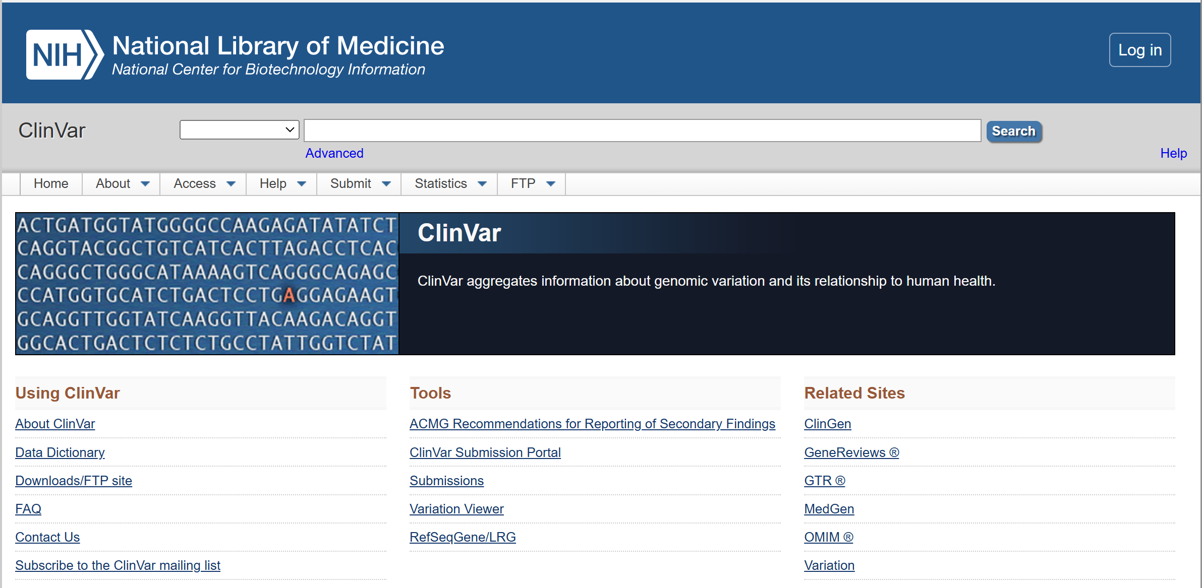
ClinVar: Reports of human variations classified for diseases and drug responses
https://www.ncbi.nlm.nih.gov/clinvar/

Slide 33
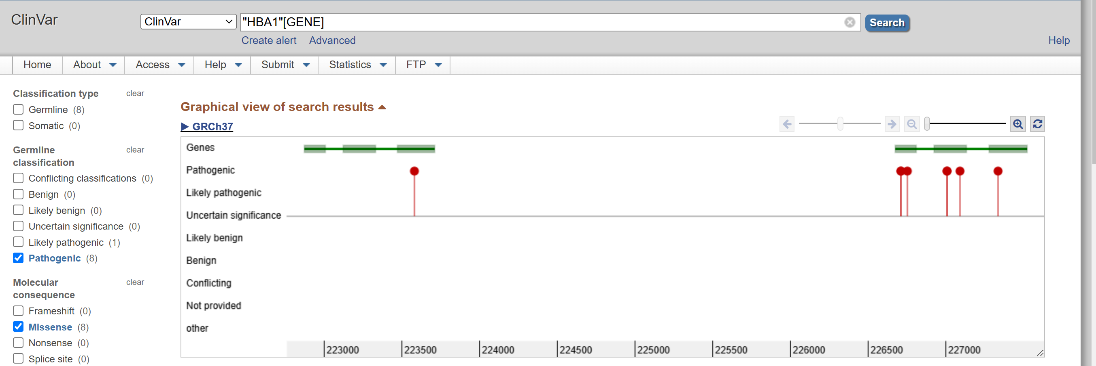
ClinVar: Reports of human variations classified for diseases and drug responses
https://www.ncbi.nlm.nih.gov/clinvar/

Slide 34
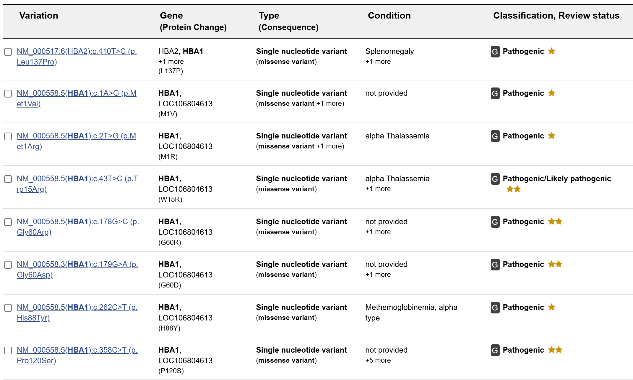
ClinVar: Reports of human variations classified for diseases and drug responses
https://www.ncbi.nlm.nih.gov/clinvar/

Slide 35
Xin chân thành cảm ơn!
Luu Phuc Loi, PhD
Zalo: 0901802182
luu.p.loi@googlemail.com

